Slide 1
ECE1512 Project-b Results walkthrough
Name: Zhe Su
Date: April 5, 2021

Slide 2
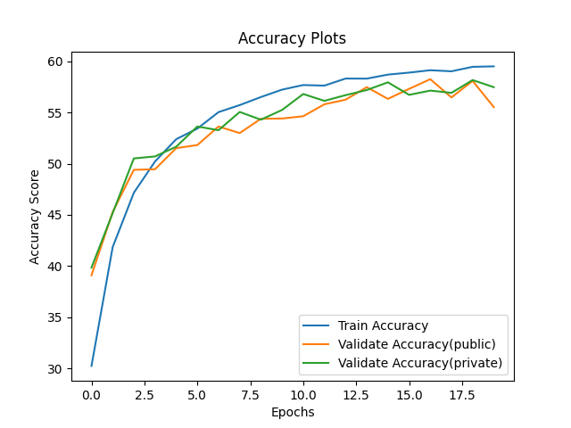
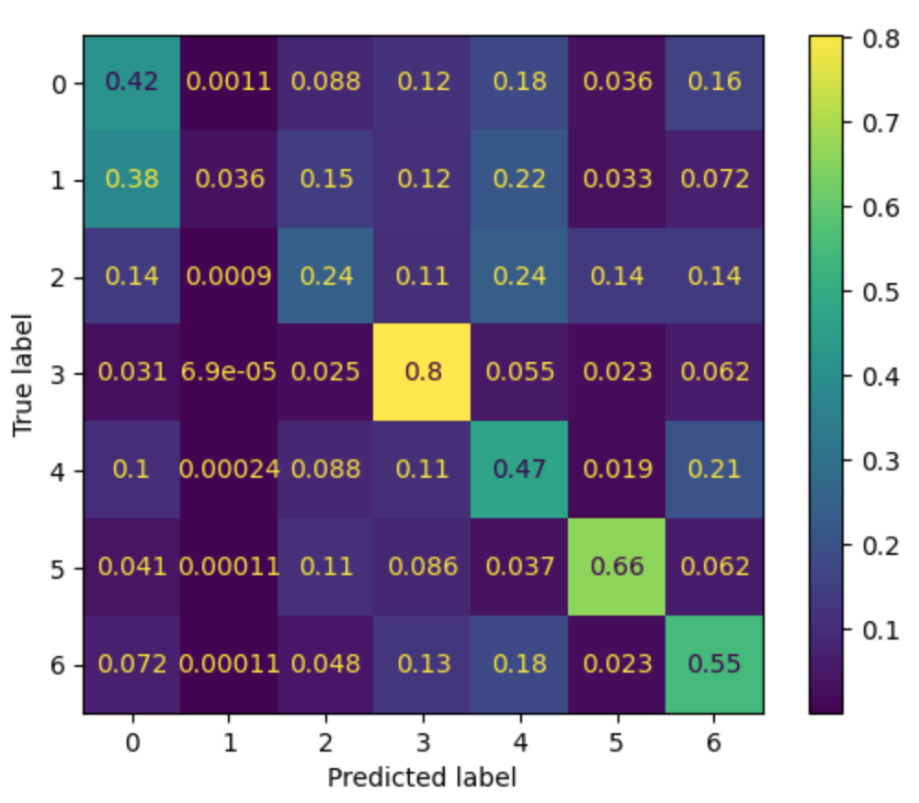
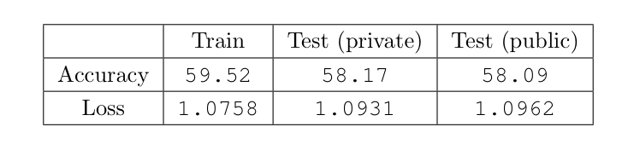
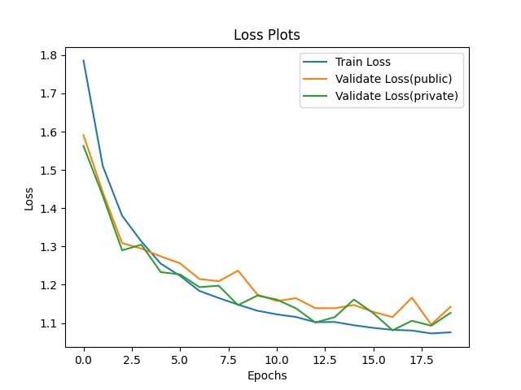
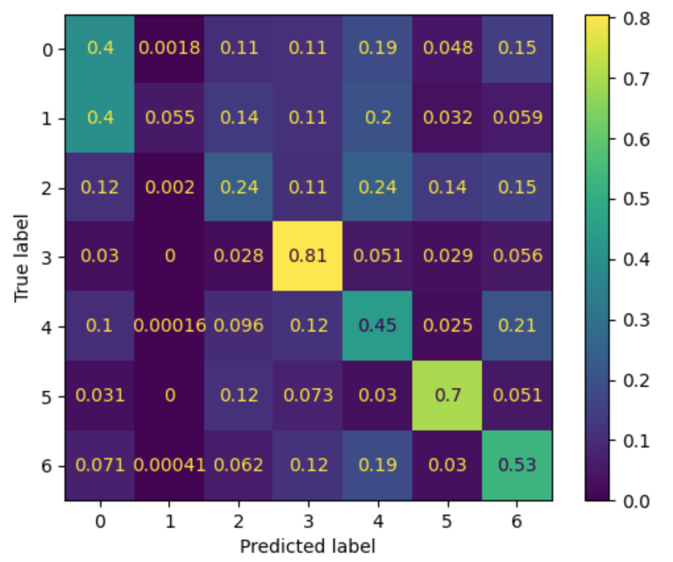
Task 1 - TRAIN
Train the specified model for 20 epochs:
Accuracy and Loss:
Confusion Matrix of training and validation data:
Label 0 to 6 represents angry, disgust, fear, happy, sad, surprise and neutral
Emotion of happy and surprise achieve the best result
Emotion of disgust achieve the worst result

Slide 3
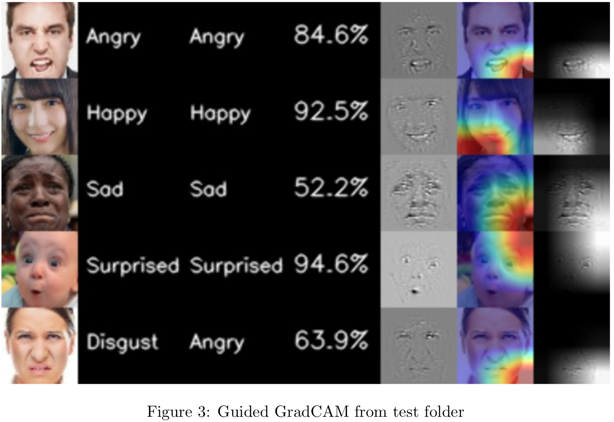
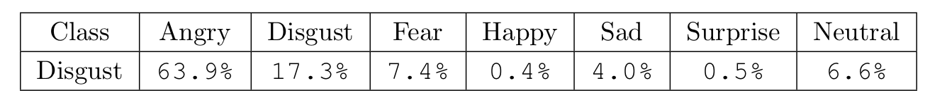
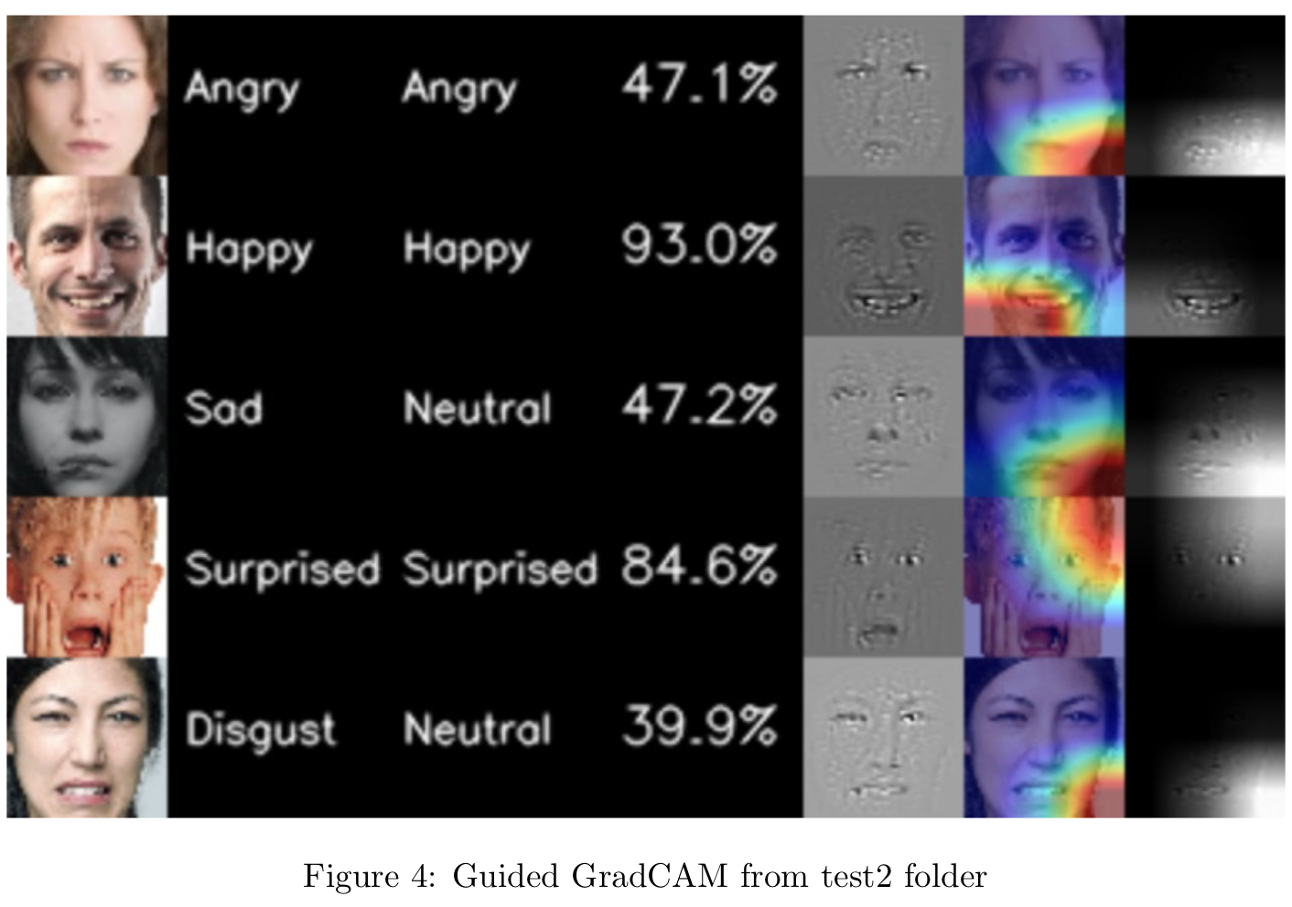
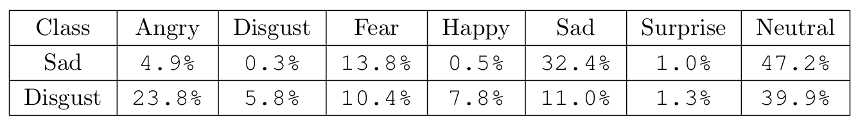
Task 1 – Performance visualization
Visualize the performance on images in test and test2:
Test
Correctly predict 4 out of 5
Prediction score on wrongly predicted class
Test2
Correctly predict 3 out of 5
Prediction score on wrongly predicted class
Emotion of happy and surprise achieve the highest confidence score

Slide 4
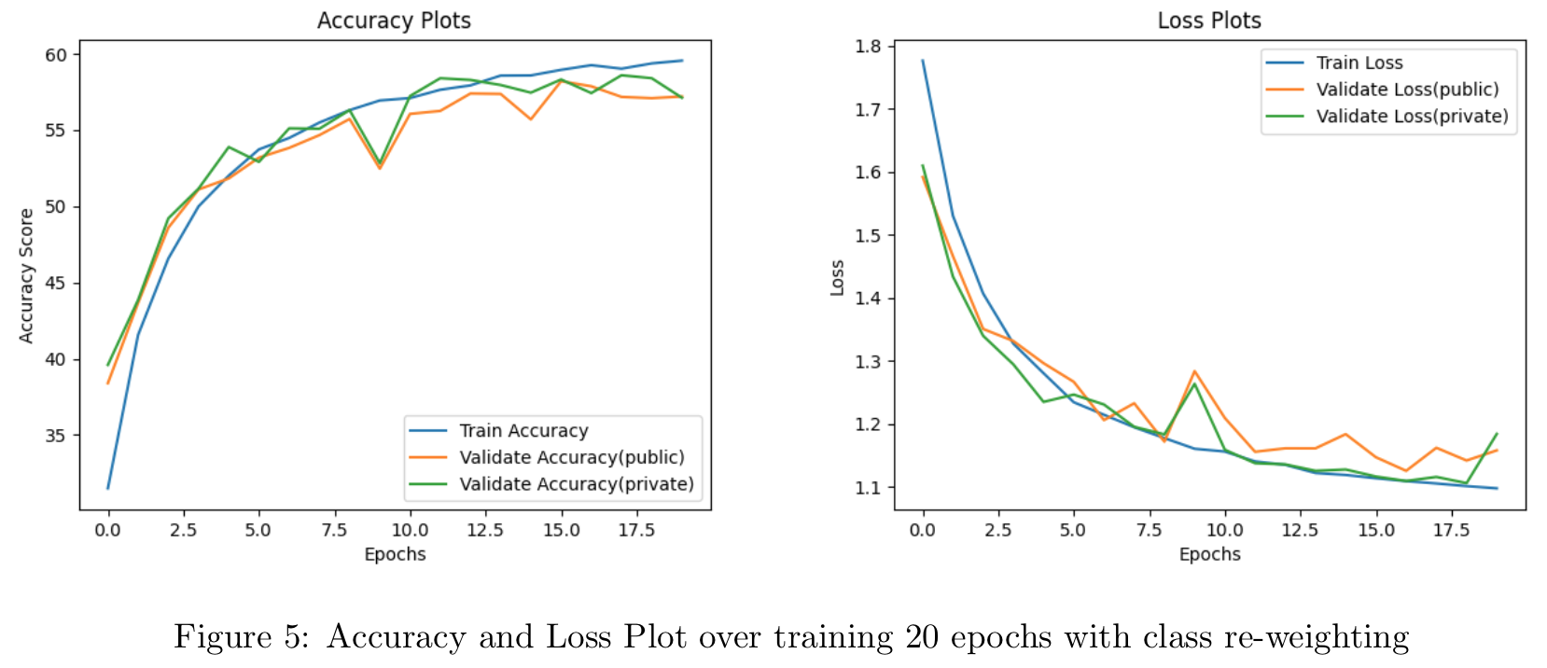
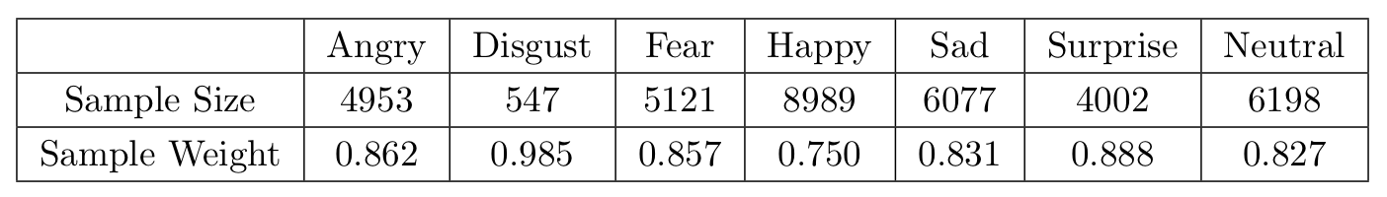
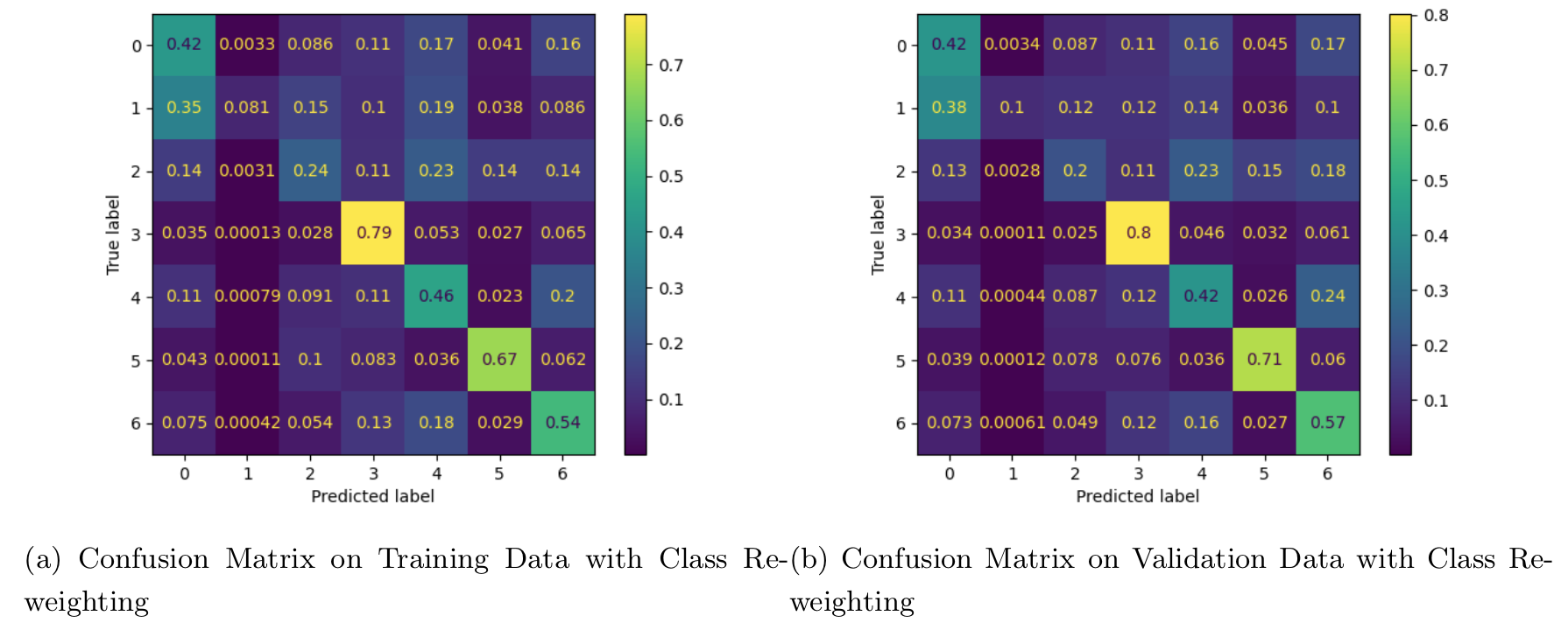
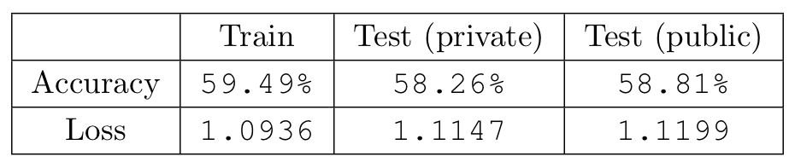
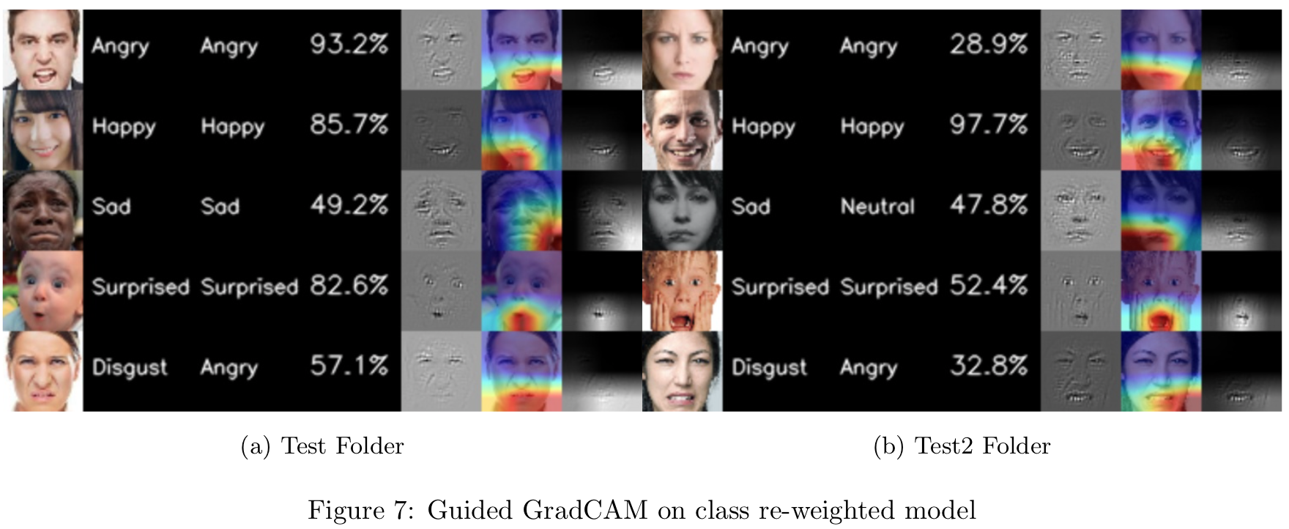
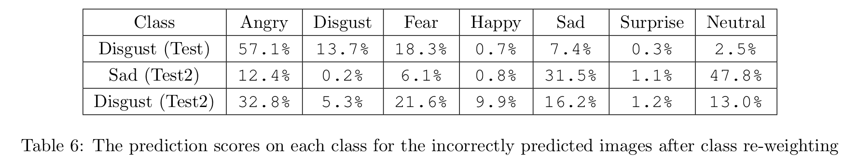
Task 1 – Small experiment (class re-weighting)
Training/Validating data distribution and linear weights
Results:
Accuracy and Loss:
Confusion Matrix:
Confidence on disgust emotion improve, confidence on happy emotion decrease.
Visualization on test and test2:
Same prediction rate as before

Slide 5
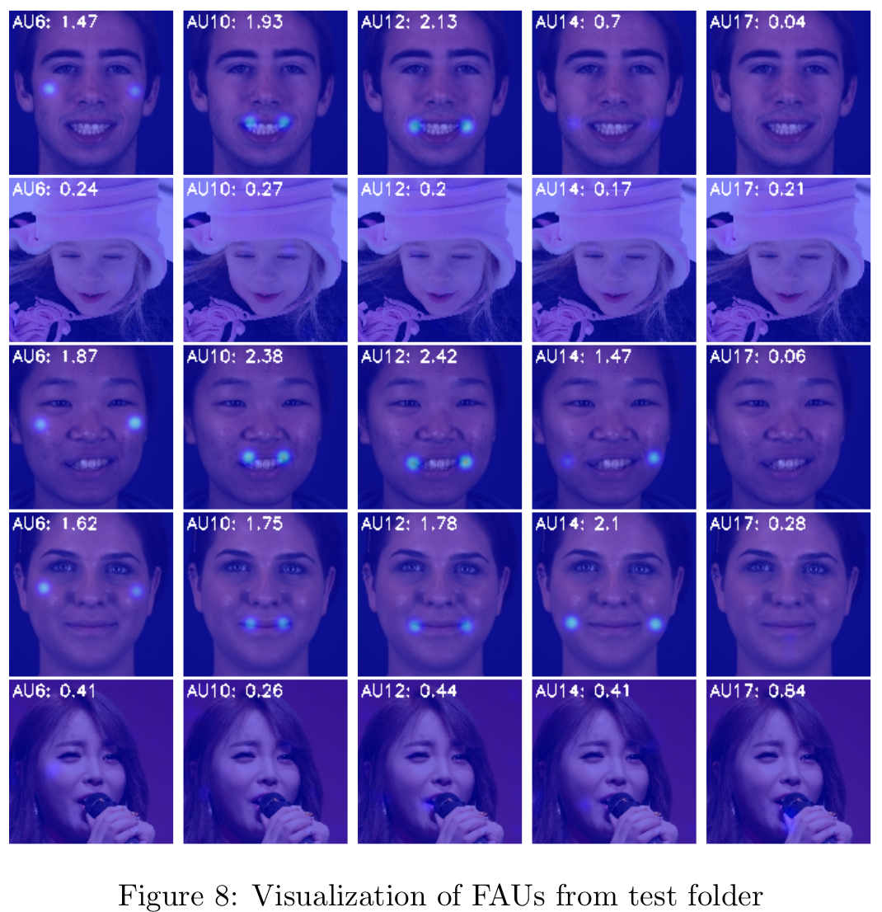
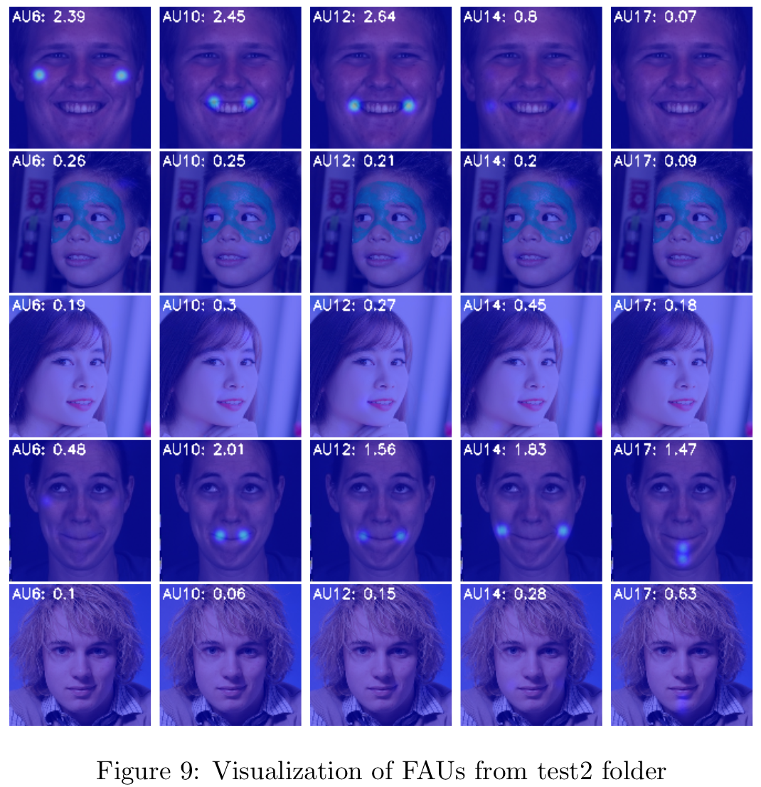
Task 2 – Model’s performance
Visualize the performance on images in test and test2 with the model without fine-tuning
Test
AU17: 0.84 (highest), 0.04 (lowest)
AU10 and AU12 achieve relatively high intensity values
Images on row 1, 3, 4 achieve higher intensity values than the others
Test2
AU17: 1.47 (highest), 0.07 (lowest)
Similarly, AU10 and AU12 out-perform on the other AUs.
Similarly, images on row 1 and 4 out-perform on the other images.
Remarks:
The facial units around lip region play more significant role in facial expression interpretation compared to facial unit around edge region such as chin
The model performs well on the subjects where only have the facial components directly displaying in the image

Slide 6
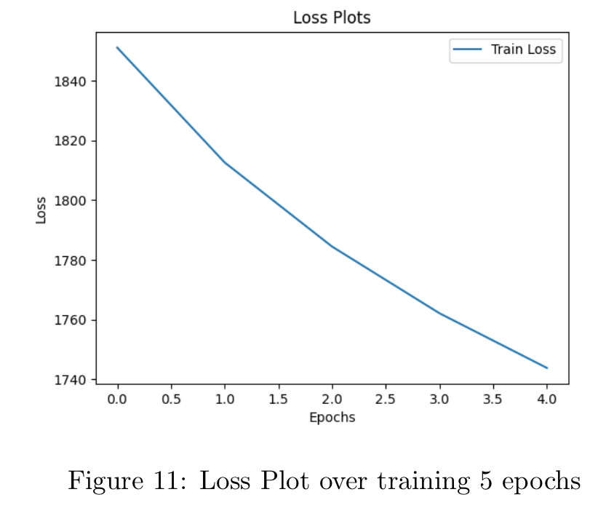
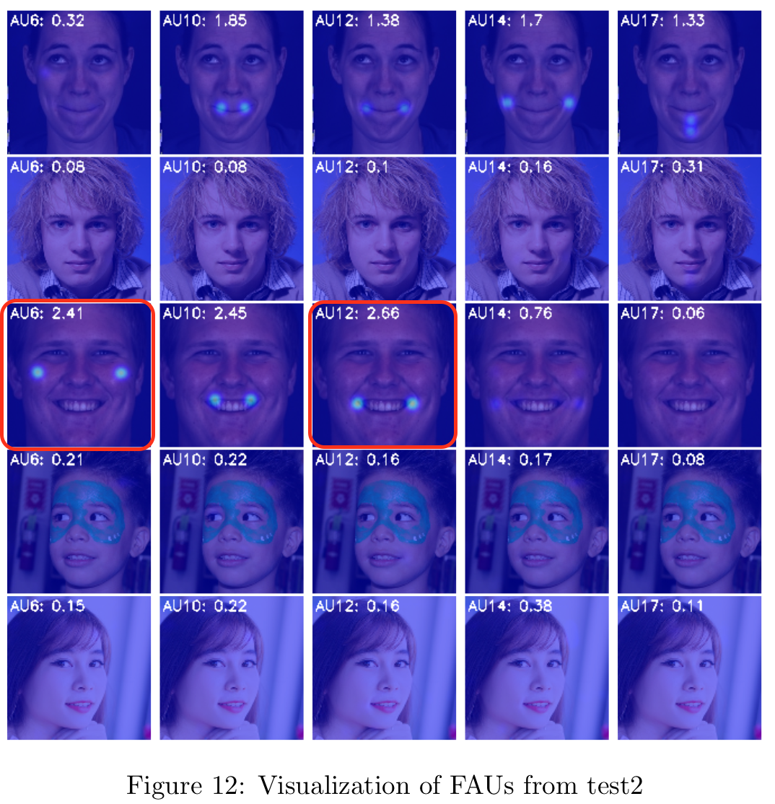
Task 1 – model tuning (contrastive learning)
Fine-tune the model for 5 epochs:
Adapt contrastive learning on 60 unlabeled data
Final tuning loss ~1750
A higher loss is acceptable since we do not want the model to unlearn original features
Performance visualization on test2
Intensity values improve on some images but fail on the others
Row 3 image (happy emotion) improve by examining AU6+AU12
The other images show with downward performance
Remarks
The model is affected when learn toward the new image samples
Model slightly unlearns the original features obtained in pre-train process
The choice on epochs, learning rate, optimizer, and loss function are important
Conducting the contrastive learning on new unlabeled data

Slide 7
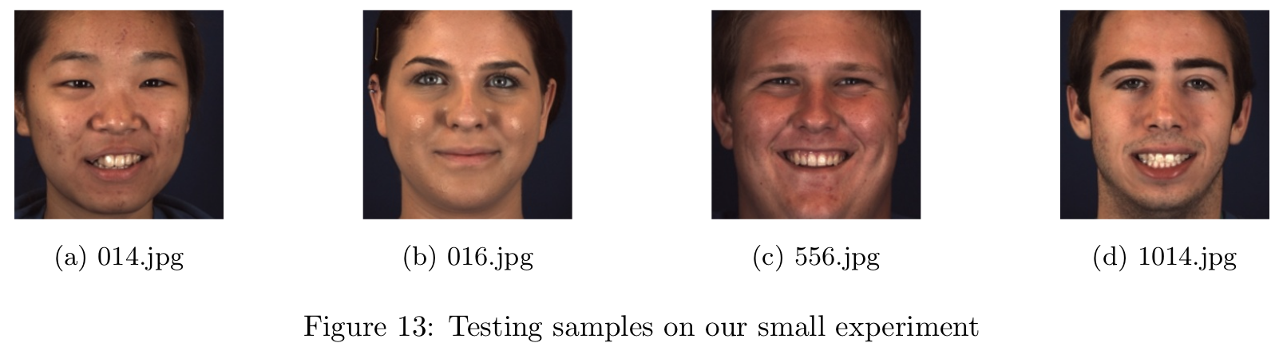
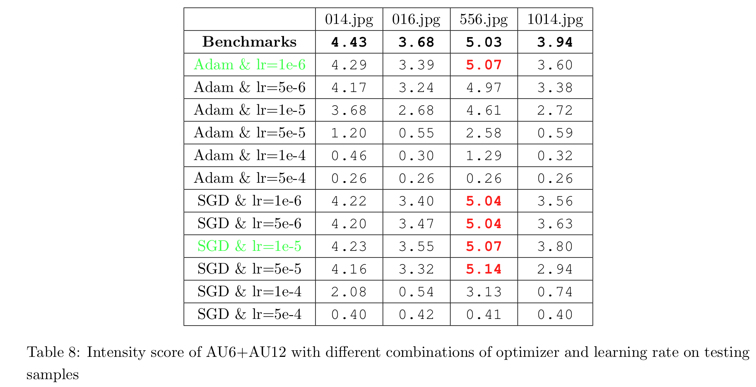
Task 2 – Small experiment on Niinuma et al.[1]
Results
Adam with 1e-6 and SGD with 1e-5 perform the best
Only 556.jpg shows with slight improvement
After long time and epochs training, intensity values become low and closed
Large learning rate drops performance dramatically
Novel Ideas
Design choices of models affect the performance of facial action intensity estimation
Image normalization, model pre-train, training size, optimizer and learning rate
Limitation: highly empirical, learned by trial and error, lack of considering model’s architecture.
Small Experiment Set-up
choose the optimizer of Adam and SGD with different learning rates while fine tuning our ResNet model 5 epochs
Evaluate AU6+AU12 on four happy emotion images
[1] Itir Onal Ertugrul Jeffrey F. Cohn Koichiro Niinuma, Laszlo A. Jeni. Unmasking the devil in the details:What works for deep facial action coding?The British Machine Vision Conference (BMVC), page 4, 092019.

Slide 8
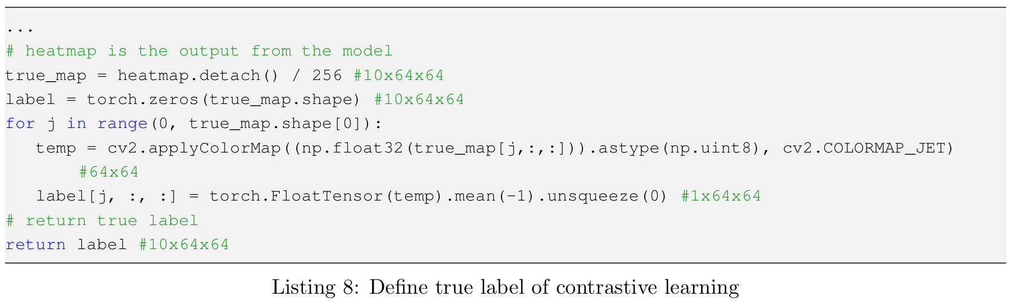
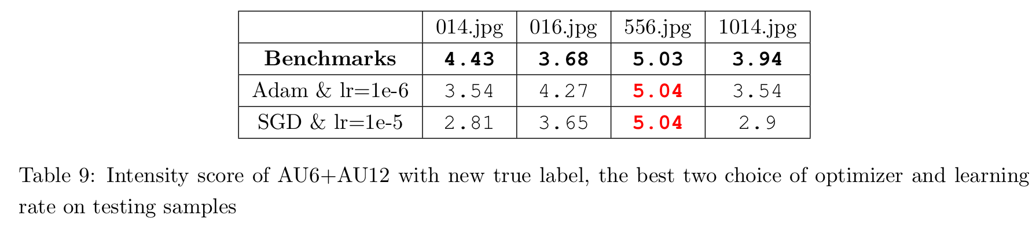
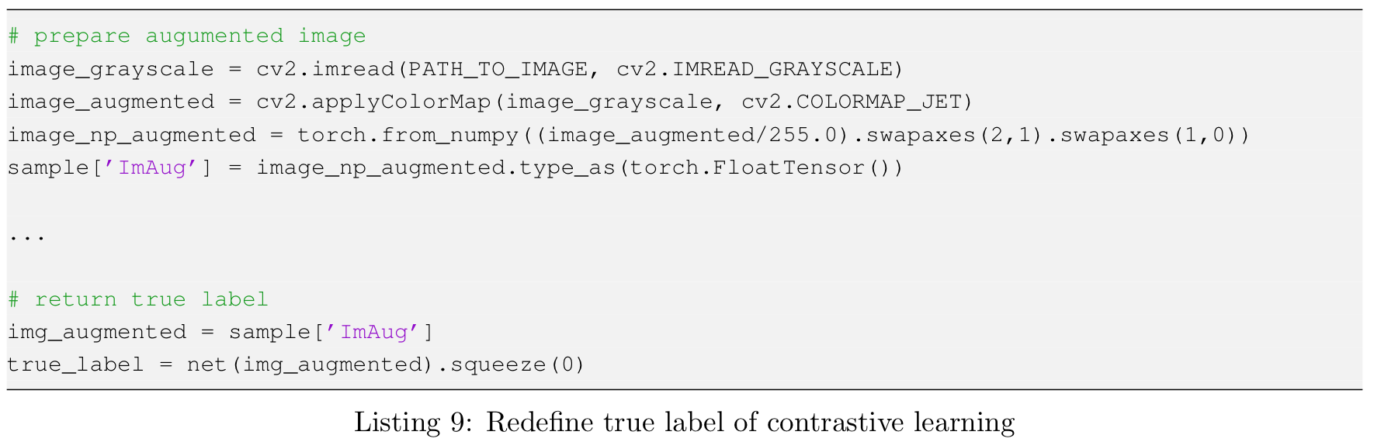
Task 2 – Small experiment on Niinuma et al.[1] CONT’D
Redefine true label for contrastive learning
As inspired by Tiu[2], redefine true label as augmenting the original image first and pass it to the model later
To examine if it could lead to a better fine-tuning result
Results
Similar results as previous
Remarks
Might be better augmented methods to define true label
Might be better loss functions other than MSE to fit on this task
Contrastive learning might not be fully compatible to our modified ResNet model and this task
[2] Ekin Tiu. Understanding contrastive learning. 2021.

